Slide 1




SWIGGY
ADVANCED SQL PROJECT
Presented By -
PARUL KOKCHA

Slide 2



ABOUT SWIGGY
Founded in India in 2014, SWIGGY is a prominent food delivery platform that has revolutionized dining with its user-friendly app, extensive restaurant options, and quick delivery services. In addition to food, it has expanded into grocery deliveries, adapting to the competitive market with continuous innovation.

Slide 3

SQL Query Crafting Data Analysis
Insights Derivation
SWIGGY DATA
MYSQL
Data Source
Tools Used
Skills enforced

Slide 4

SQL QUERIES ANALYSIS

Slide 5

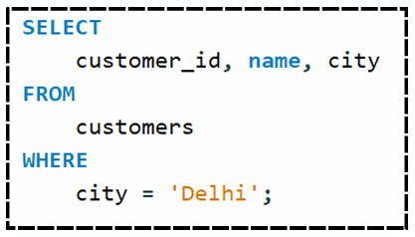
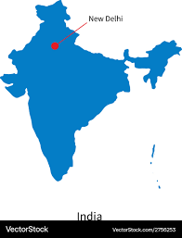
DISPLAY ALL CUSTOMERS WHO
LIVE IN ‘DELHI’

Slide 6
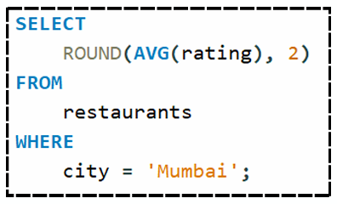

FIND THE AVERAGE RATING OF ALL THE RESTAURANTS IN ‘MUMBAI’

Slide 7
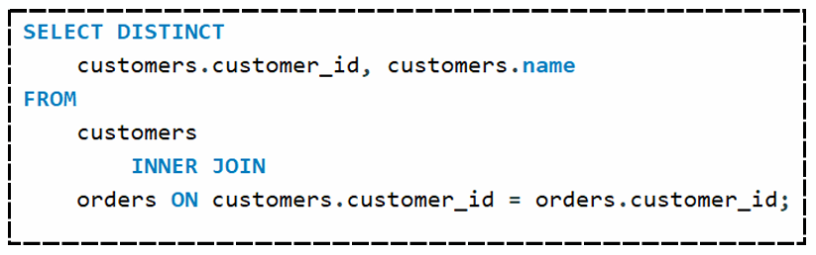

LIST ALL CUSTOMERS WHO HAVE PLACED ATLEAST ONE ORDER.

Slide 8

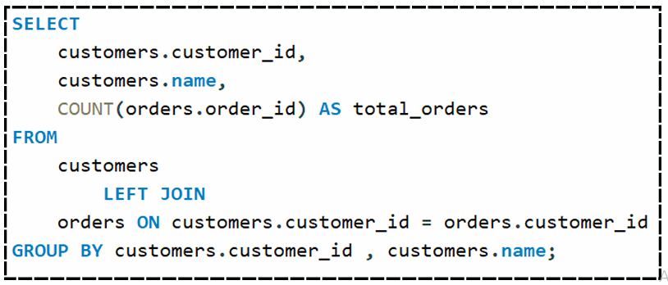
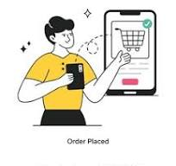
DISPLAY THE TOTAL NUMBER OF ORDERS PLACED BY EACH CUSTOMER.

Slide 9
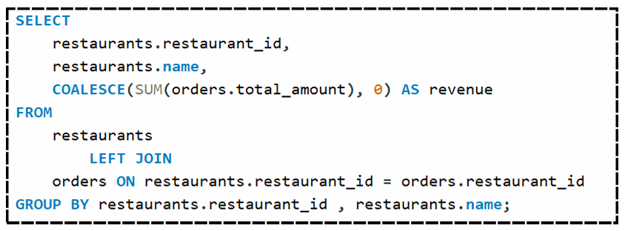

FIND THE TOTAL REVENUE GENERATED BY EACH RESTAURANT.

Slide 10
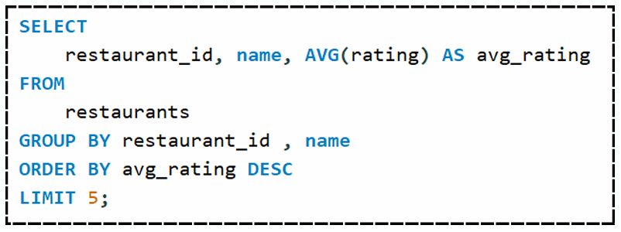

FIND THE TOP 5 RESTAURANTS WITH THE HIGHEST AVERAGE RATING.

Slide 11
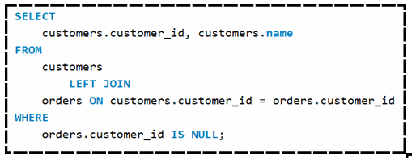
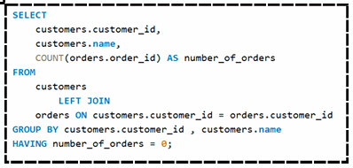
DISPLAY ALL CUSTOMERS WHO HAVE NEVER PLACED AN ORDER.
Method 1
Method 2

Slide 12
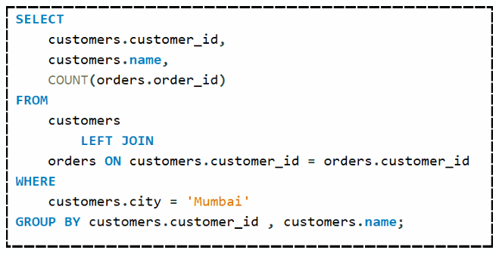
FIND THE NUMBER OF ORDERS PLACED BY EACH CUSTOMER IN ‘MUMBAI’.

Slide 13

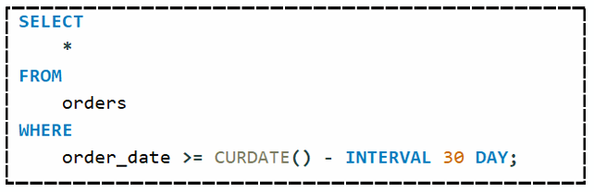

DISPLAY ALL ORDERS PLACED IN THE LAST 30 DAYS.

Slide 14

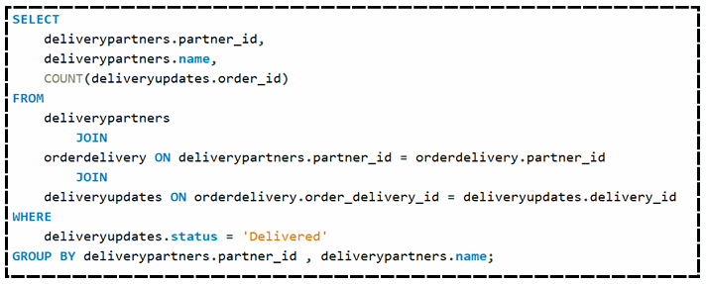

LIST ALL DELIVERY PARTNERS WHO HAVE COMPLETED MORE THAN 1 DELIVERY.

Slide 15

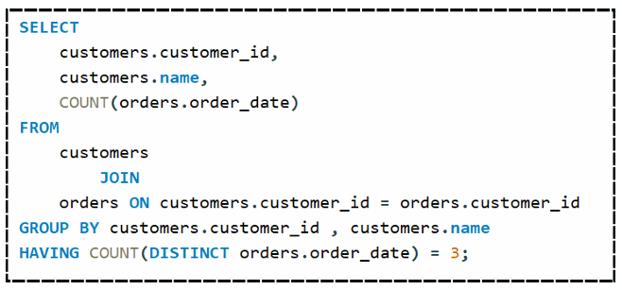

FIND THE CUSTOMERS WHO HAVE PLACED ORDERS ON EXACTLY THREE DIFFERENT DAYS.

Slide 16
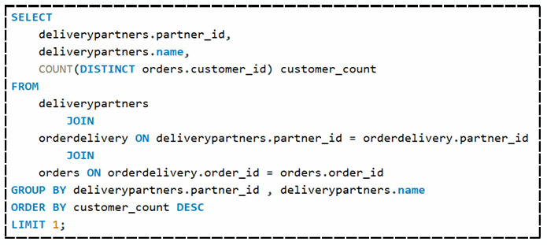

FIND THE DELIVERY PARTNER WHO HAS WORKED WITH THE MOST DIFFERENT CUSTOMERS.

Slide 17

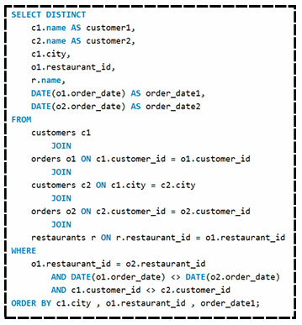
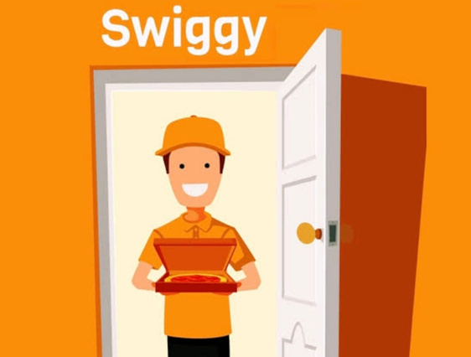
IDENTIFY THE CUSTOMERS WHO HAVE THE SAME CITY AND HAVE PLACED ORDERS AT THE SAME RESTAURANTS BUT ON DIFFERENT DATES.

Slide 18





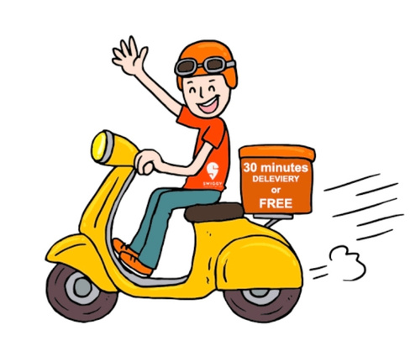

THANK YOU!

